Slide 1

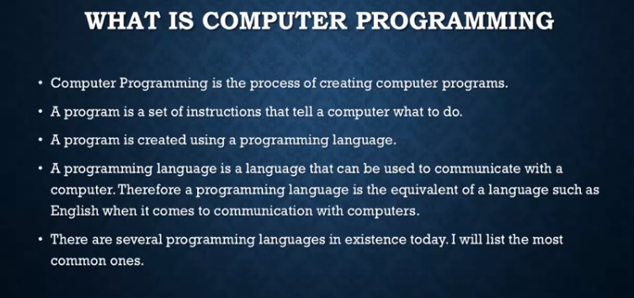
What is Programming?

Slide 2
Purpose of Programming?
The purpose of programming is to automate the manual processes.
The purpose of programming is to find a sequence of instructions that will automate performing a specific task or solving a given problem.
The process of programming thus often requires expertise in many different subjects, including knowledge of the application domain, specialized algorithms, and formal logic.

Slide 3
Roles of a Programmer?
Computer programmers are those who write computer software. Their jobs usually involve:
Requirements analysis
Coding
Debugging
Documentation
Integration
Maintenance
Software testing

Slide 4
Programming Languages
C
C++
Java
.NET
PHP
ColdFusion
VB
Cobol
…and many more..

Slide 5
Types of computer Applications ?
Here is a small list of different types of computer applications.
1. Embedded Systems
2. Windows applications (also called 'Desktop applications')
3. Web Applications
4. Web Services
5. Console applications

Slide 6
What Is Microsoft Visual Studio ?
Microsoft Visual Studio is an integrated development environment (IDE) from Microsoft.
It is used to develop computer programs for Windows apps, as well as web sites, web apps, web services and mobile apps.
Visual Studio uses Microsoft software development platforms such as Windows API, Windows Forms, Windows Presentation Foundation, Windows Store and Microsoft Silverlight.

Slide 7
Microsoft Visual Studio Versions ?
.NET Version | IDE
4.7 | Visual Studio 2017
4.6 | Visual Studio 2015
4.5.1 | Visual Studio 2013
4.5 | Visual Studio 2012
4 | Visual Studio 2010
3.5 | Visual Studio 2008
3 | Visual Studio 2006
2 | Visual Studio 2005
1.1 | Visual Studio 2003
1 | Visual Studio .Net

Slide 8

What Is .NET?
Microsoft .NET, is a platform for developing “managed” software. The word managed is key here—a concept setting the .NET platform apart from many other development environments.
Traditional compilation- In the traditional compilation process, the executable file is binary and can be executed by the operating system immediately.

Slide 9
Object Oriented Programming
Why?

Slide 10
Procedural Approach
Focus is on procedures
All data is shared: no protection
More difficult to modify
Hard to manage complexity

Slide 11
OOPs Concepts
It is a system modeling technique in which the system is design with using discrete objects.
The basic components of OOP’s are:-
Class:- It is written description of objects, It is collection of properties and behaviors.
Object:- They are real time things, something that exist, something that is used.
Object is anything that is identifiable as a single material item.

Slide 12





Objects and Classes
Classes reflect concepts, objects reflect instances that embody those concepts.
object
class
girl
Jodie
Daria
Jane
Brittany

Slide 13
Objects and Classes
Class
Visible in source code
The code is not duplicated
Object
Own copy of data
Active in running program
Occupies memory
Has the set of operations given in the class

Slide 14
Objects and Classes
A class captures the common properties of the objects instantiated from it
A class characterizes the common behavior of all the objects that are its instances

Slide 15
Instantiation
An Object is instantiated from a Class
Objects without memory is called Object and
Objects with memory is called Instance.
Note:- Only instance of classes are used in the program.
MyClass1 ob;
ob = new MyClass1;

Slide 16
Different Types of Variables:
Class Variable: They are Static members and accessed with the name of class rather than reference to objects. (by using “Static” keyword)
Instance Variable: They are used with instance not through class.
Local Variable: They are defined within a method

Slide 17
Examples of Variables
Class Employee
{
private static int C_vbl;
private int I_vbl;
Public void Class_Method()
{
int L_variable=100;
}
}

Slide 18
Properties of OOP’s
Key Concepts of Object Orientation
Encapsulation
Abstraction
Inheritance
Polymorphism

Slide 19
Data Encapsulation
How the object *should* be used.
It allow you to hide internal state of objects and abstract access to it though type members such as
Access Modifiers, methods, properties, and indexers.

Slide 20
Access Modifiers
C# provides us following 5 access modifiers:
Private: Used within the same class
Protected: Can be used by Inheritance class
Public: Can be excess by anyone
Internal: Can be used within the same project
Protected Internal: Can be used by Inheritance in same project.

Slide 21
Access Modifier Example
Class Employee
{
Private int ID;
Private string NAME;
Public void GetDetails()
{
--------
}
Public void ShowDetails()
{
----------
}
}
Tips:- In construction of class prefer to use “Private” access for fields and “Public” access for methods.
We can access a private field of class by defining it into a public method of that class.

Slide 22
C# Properties
Properties are members that provide a flexible mechanism to read, write or compute the values of private fields
Properties can be used as if they are public data members, but they are actually special methods called Accessors.
It enables data to be accessed easily and still helps promote the safety and flexibility of methods.

Slide 23
Accessors of Properties
GET: To read value from the field
SET: To write Value into the field
Tip:- SET uses an implicit parameter called “Value”, whose type is the type of the property within its declaration.
Tip:- The methods in which argument are not passed are called accessor.

Slide 24
Implementation of Properties
Using System;
Class Employee
{
private int ID;
public int IDNO
{
get
{
return ID;
}
set
{
ID=Value;
}
}
}
Public static void main(String []args)
{
Employee e1= new Employee();
e1.IDNO= 1010
C.W.L(“The given value of IDNO IS:”+ e1.IDNO)
}

Slide 25
Categories of C# Properties
Read Only Properties:- properties that have only GET accessor.
Write Only Properties:- properties that have only SET accessor.
Read/Write Properties:- Having both GET and SET accessor.
Auto-Implemented Properties:- When no additional logic is required, we can declare properties as shown below
Public int EMPNO
{
get;
set;
}
Tip:- To create a read-only auto- implemented property, give it a private SET accessor
Tip:- Auto-implemented property must declare both GET and SET accessor.

Slide 26
Advantages of Encapsulation
Protection
Consistency
Allows change

Slide 27
Inheritance
A class which is a subtype of a more general class is said to be inherited from it.
The sub-class inherits the base class’ data members and member functions
A sub-class has all data members of its base-class plus its own
A sub-class has all member functions of its base class (with changes) plus its own
Tips:- Every class in C# is Inherited from System.Object Class of C#.(Base Class)

Slide 28
Is-a Relationship in Inheritance
Animal
Mammal
Reptile
Generalization
Specialization
Rodent
Primate
Cats
Mouse
Squirel
Rabbit
Mammal IS-A Animal, Mammal HAS-A Cat

Slide 29
Inheritance: BaseClass
using System; public class ParentClass { public ParentClass() { Console.WriteLine("Parent Constructor."); } public void print() { Console.WriteLine("I'm a Parent Class."); } } public class ChildClass : ParentClass { public ChildClass() { Console.WriteLine("Child Constructor."); } public static void Main() { ChildClass child = new ChildClass(); child.print(); } }
Output:
Parent Constructor.
Child Constructor.
I'm a Parent Class.

Slide 30
Type of Inheritance
Single Inheritance:- When a derived class is derived from a single base.
Multiple Inheritance:- When a derived class is derived from more than one base class.
Note:- C# does not support multiple Inheritance of classes.
Tip:- In Inheritance private attributes of base class does not take part only public & protected attributes are inherited.
Tip:- When two methods have same signature(name, attribute) in Base class and derived class, then the derived class method will overwrite the base class method.

Slide 31
Constructor & Destructor in Inheritance
They are not inherited from base class to derived class
But we can explicitly invokes base class constructors with derive class using Base keyword.
The sequence of invoke for constructors are
Constructor Destructor
Base Class
Derived Class

Slide 32
Example of Constructor
Class Myclass()
{
Public Myclass()
{
C.W.L(“Base Class Constructor!!”);
}
~Myclass()
{
C.W.L(“Base Class Destructor!!”)
}
}
Class Myderive:Myclass
{
public Myderive()
{
C.W.L(“My derive class constructor!!”)
}
~Myderive()
{
C.W.L(“My derive class Destructor!!”)
}
}
Public static void main()
{
Myderive ob= new Myderive();
}
Output:
My base class constructor!!
My derive class constructor!!
My derive class Destructor!!
My base class Destructor!!

Slide 33
Types of Constructors
Default constructor:- Executed when object of class is created
Static constructor:- executed once, when first object of class is created, Use to initialize static fields.
Parametric constructor:- Use to initialize the fields
Example:-
Class employee
{
Private int x
Public employee() // default constructor
{
x=10;
}
Public employee (int a) // parametric constructor
{
x=a;
}
Static employee() // static constructor
{
console.writeline(“my static constructor”)
}
}

Slide 34
Polymorphism
One interface
Multiple implementations
Inheritance
This relationship between virtual methods and the derived class methods that override them enables polymorphism.
It allows you to invoke derived class methods through a base class reference during run-time.
Tip:- A base class object can hold reference of all derive class object, but wise versa is not possible.

Slide 35
Virtual Methods
They are used to achieve run-time polymorphism in C#.
A virtual method is needed to override with “Override” keyword.
We can declare a virtual methods and property by using “Virtual” keyword.

Slide 36
Virtual Method Declaration
using System; public class DrawingObject { public virtual void Draw() { Console.WriteLine("I'm just a generic drawing object."); } }
public class Line : DrawingObject { public override void Draw() { Console.WriteLine("I'm a Line."); } } public class Circle : DrawingObject { public override void Draw() { Console.WriteLine("I'm a Circle."); } }

Slide 37
Implementing Polymorphism
using System; public class DrawDemo { public static int Main( ) { DrawingObject[] dObj = new DrawingObject[3]; dObj[0] = new Line(); dObj[1] = new Circle(); dObj[2] = new DrawingObject(); foreach (DrawingObject iObj in dObj) { iObj.Draw(); } } }
Tip:- We can not use the Virtual modifier with the Static, Abstract, Private or Override modifier.

Slide 38
Abstract Class
Abstract class is a class which contains one or more abstract method
We can declare an abstract class using “Abstract” keyword.
An abstract method is a method which declaration is given somewhere and its definition is given somewhere else.
In general abstract methods are declare in Base class and their definition is given in derived class.

Slide 39
Syntax for abstract class and their methods
Abstract class myclass
{
public abstract void message();
}
Class checkabs:myclass
{
public override void message()
{
console.writeline(“my abstract method”)
}
}
Class program
{
static void main()
{
checkabs ob= new checkabs();
ob.message();
}
}

Slide 40
Tips
We can create an object of abstract class, but we can’t instantiation it.
We can store the reference of a derive class in abstract class object.
Example:-
{
myclass ob= new checkabs();
ob.message();
}

Slide 41
Interfaces
It is also a reference type same as class, but it can not contain any definition within it.
It only declares the member within it.
Interface are also known as class with restrictions.
We can declare interface using “Interface” keyword , generally interface name start’s with “I” latter.
Syntax:-
Interface Iface
{
//member declaration
}

Slide 42
Tips for using Interface
Interface can not contain any implementation
Interface methods are implicitly public & abstract
Interface member cannot be static or virtual
Interface can’t contain constructor or destructor.
Any non-abstract class inheriting interface must implement all its members.
Interface can contain events, indexes, methods and properties, but it can not contain fields.

Slide 43
Tips for Interface
Interface can’t be instantiated directly.
Interface contain no implementation of methods.
Classes and structs can inherit more than one interface.
An interface can inherit another interface.
We can inherit multiple interface in a derive class
Note:- we must override the interface method in derive class only by using public access- specifier.

Slide 44
Syntax for Interface
Public interface Iface1
{
Void fun1() ;
}
Class myclass: Iface1
{
Public void fun1()
{
console.writeline(“My Interface”)
}
}

Slide 45
Sealed Class
Sealed class are primarily used to prevent derivation.
They can never be used as a base class
Syntax:-
Sealed class mybase
{
}
Class myderive:mybase
{
// Will raise an error
}

Slide 46
Sealed Method
Sealed modifier prevents a methods to be overridden by a derived class.
We can use “sealed” keyword to declare sealed method
Tip:- we can’t use sealed keyword with a base class method.
Tip:- we can not use sealed keyword with a non- virtual method.

Slide 47
Summary
What is Object Oriented Programming?
Object-oriented programming is a method of implementation in which programs are organized as cooperative collections of objects, each of which represents an instance of some class, and whose classes are all members of one or more hierarchy of classes united via inheritance relationships

Slide 48
What Is .NET?
Microsoft .NET, is a platform for developing “managed” software. The word managed is key here—a concept setting the .NET platform apart from many other development environments.
Traditional compilation- In the traditional compilation process, the executable file is binary and can be executed by the operating system immediately.

Slide 49
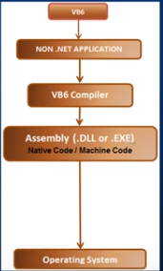
Traditional compilation

Slide 50
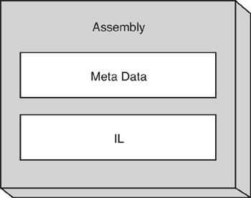
Managed compilation
Managed compilation-In the managed environment of .NET, the file produced by the compiler (the C# compiler in our case) is not an executable binary. Instead, it is an assembly.
This intermediate language is called Microsoft Intermediate Language (MSIL), which is commonly referred to as IL

Slide 51
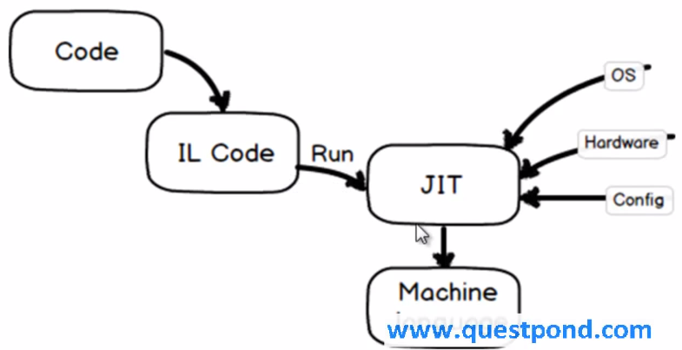
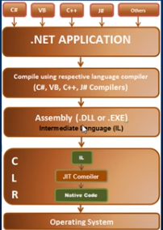
Managed compilation

Slide 52
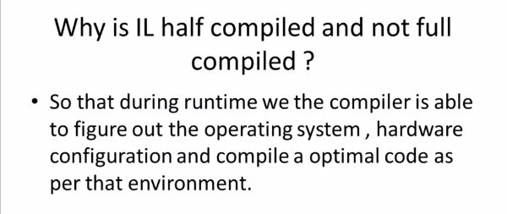
Managed compilation

Slide 53
CLR
As part of the Microsoft .NET Framework, the Common Language Runtime (CLR) is the programming (Virtual Machine component) that manages the execution of programs written in any language that uses the .NET Framework, for example C#, VB.Net, F# and so on.
Programmers write code in any language, including VB.Net, C# and F# yhen they compile their programs into an intermediate form of code called CLI in a portable execution file (PE) that can be managed and used by the CLR and then the CLR converts it into machine code to be will executed by the processor.
The information about the environment, programming language, its version and what class libraries will be used for this code are stored in the form of metadata with the compiler that tells the CLR how to handle this code.
The CLR allows an instance of a class written in one language to call a method of the class written in another language.

Slide 54
CLR
Functions of the CLR
Convert code into CLI.
Exception handling
Type safety
Memory management (using the Garbage Collector)
Security
Improved performance
Language independency
Platform independency
Architecture independency

Slide 55
GC
The Garbage collection is very important technique in the .Net framework to free the unused managed code objects in the memory and free the space to the process
When we have a class that represents an object in the runtime that allocates a memory space in the heap memory. All the behavior of that objects can be done in the allotted memory in the heap. Once the activities related to that object is get finished then it will be there as unused space in the memory.

Slide 56
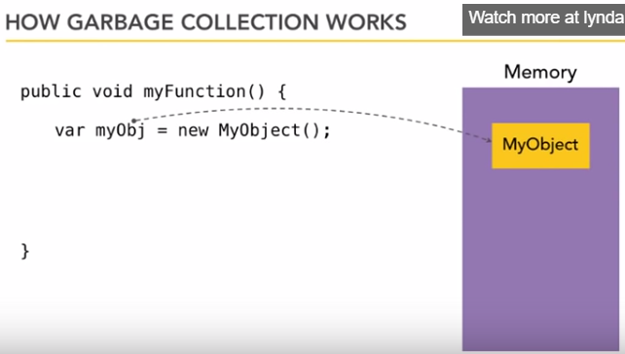
GC

Slide 57
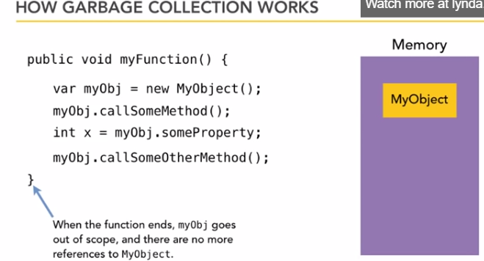
GC

Slide 58
GC

Slide 59
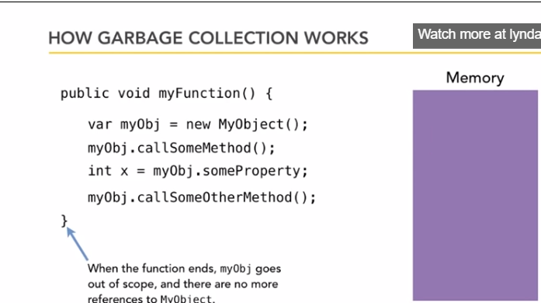
GC

